Slide 1
Employee Exit Job Aid

Slide 2
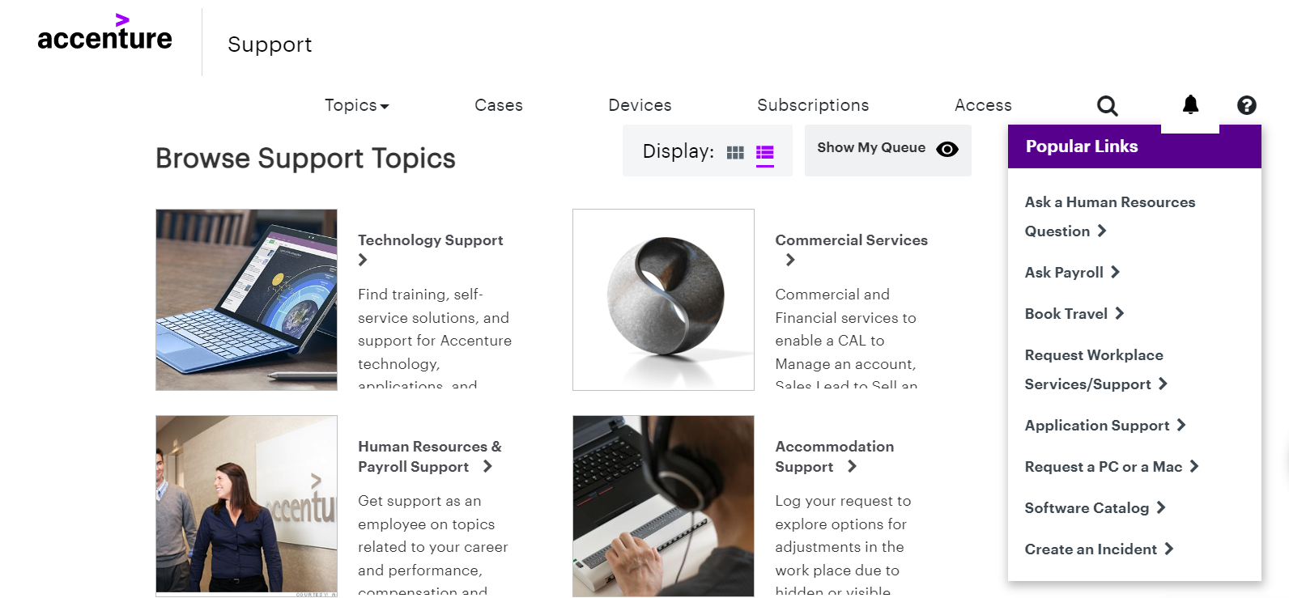
Employee Exit Job Aid
1
In Chrome, go to https://Support.Accenture.com
2
Click on the Human Resources & Payroll Support Tile
1

Slide 3
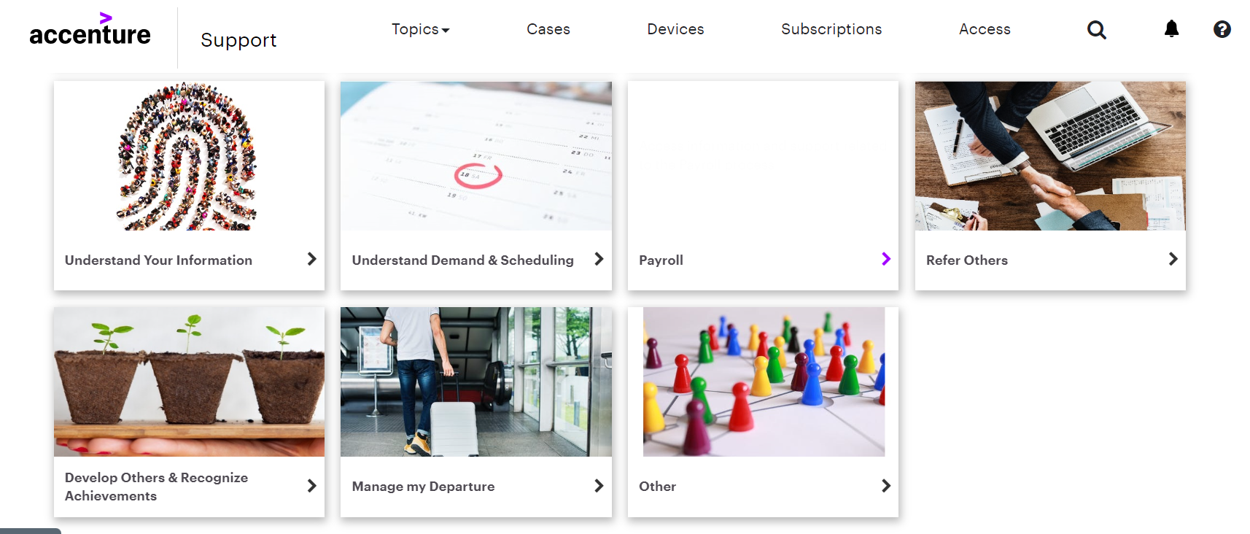
Employee Exit Job Aid
3
Click on the Manage my Departure Tile
2

Slide 4
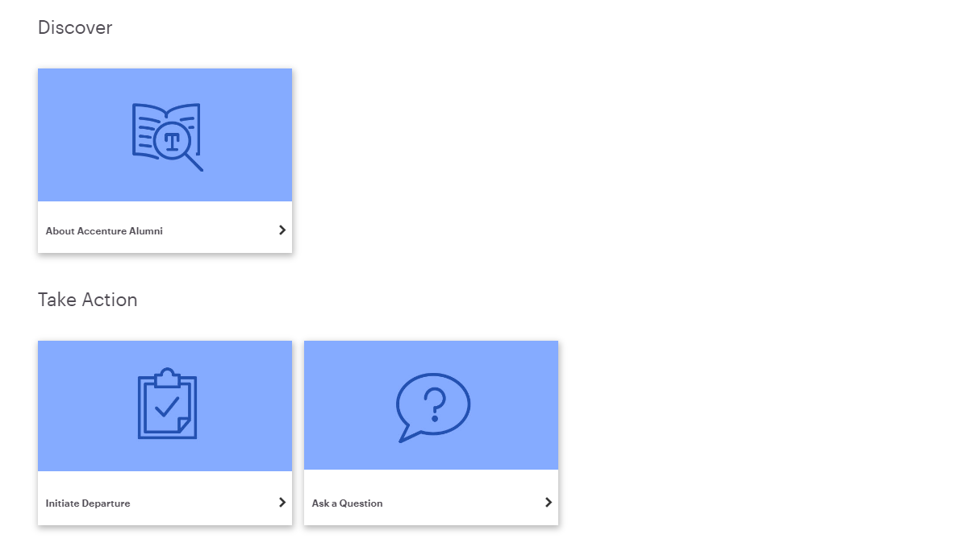
Employee Exit Job Aid
4
Click on the Initiate Departure Tile
3

Slide 5
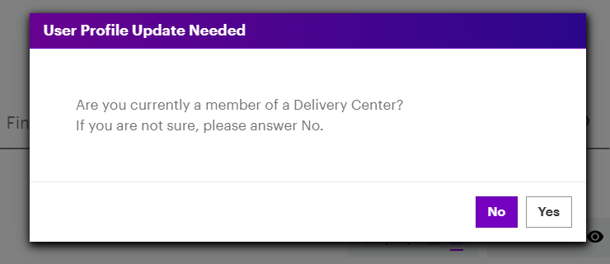
Employee Exit Job Aid
If the User Profile is not complete, the User Profile Update Needed box appears
5
6
Select the correct button
4

Slide 6

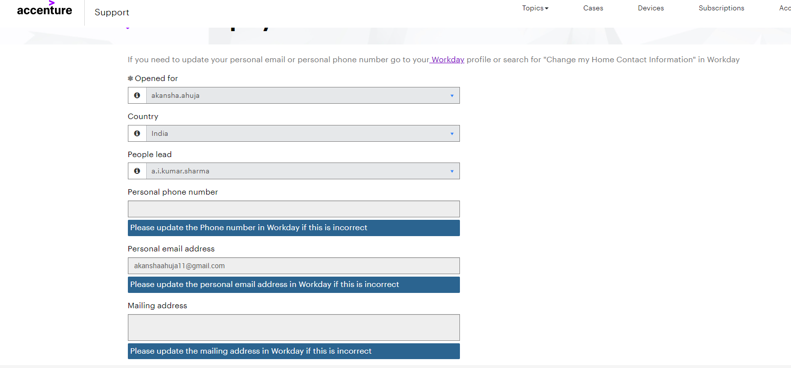
Employee Exit Job Aid
Note! If the Personal phone number or Personal email address fields are blank or need to be updated, the information must be changed in Workday before this form can be submitted
5

Slide 7
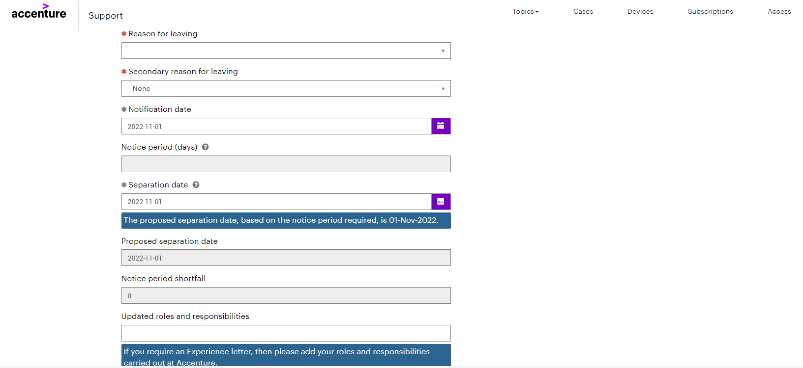
Employee Exit Job Aid
7
Use the dropdown to select the Reason for leaving
8
Use the dropdown to select a Secondary reason for leaving. If there isn’t one, select Not Applicable
9
Use the calendar to change the Notification date, if needed. Notification date is the date the resignation has been communicated.
10
Use the calendar to change the Separation date, if needed. The Separation date is the last day at Accenture
Note! Proposed separation date is the separation date as per applicable notice period
If an Experience letter is required, enter the Updated roles and responsibilities
11
6

Slide 8
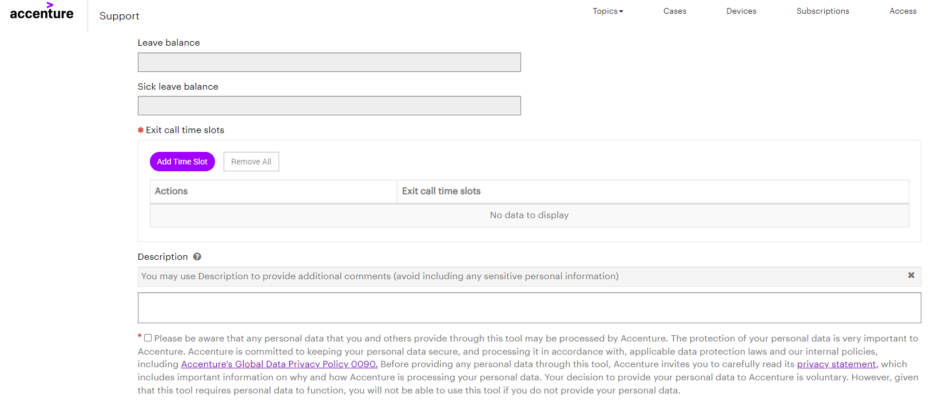
Employee Exit Job Aid
12
Enter Exit call time slots (see next slide for further details)
13
Enter any additional comments in the Description field
7

Slide 9
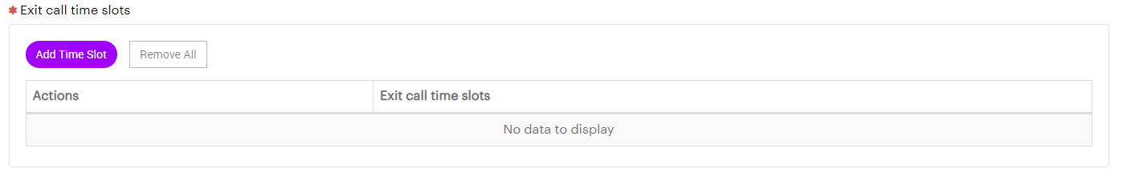
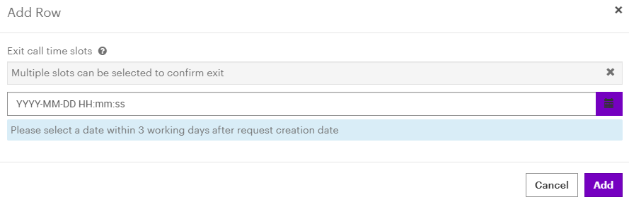
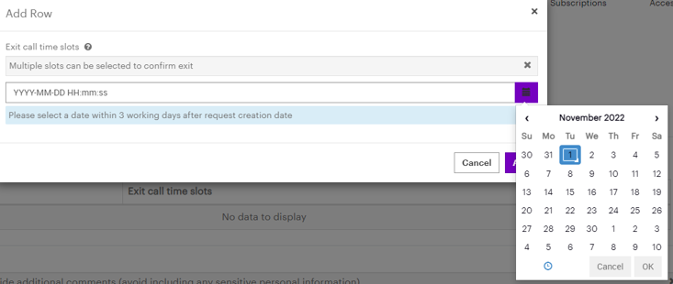
Employee Exit Job Aid
14
To Enter Exit call time slots, click on Add Time Slot
15
The Add Row pop up
box appears. Click the calendar button (see below)
Note! A date must be selected within three days of initiating the departure. The system will not allow a date further out to be picked
The calendar appears. Select a date within three days and click ok. Multiple dates can be selected. Repeat the process to select additional dates.
16
17
Once all the dates have been selected, click Add
8

Slide 10
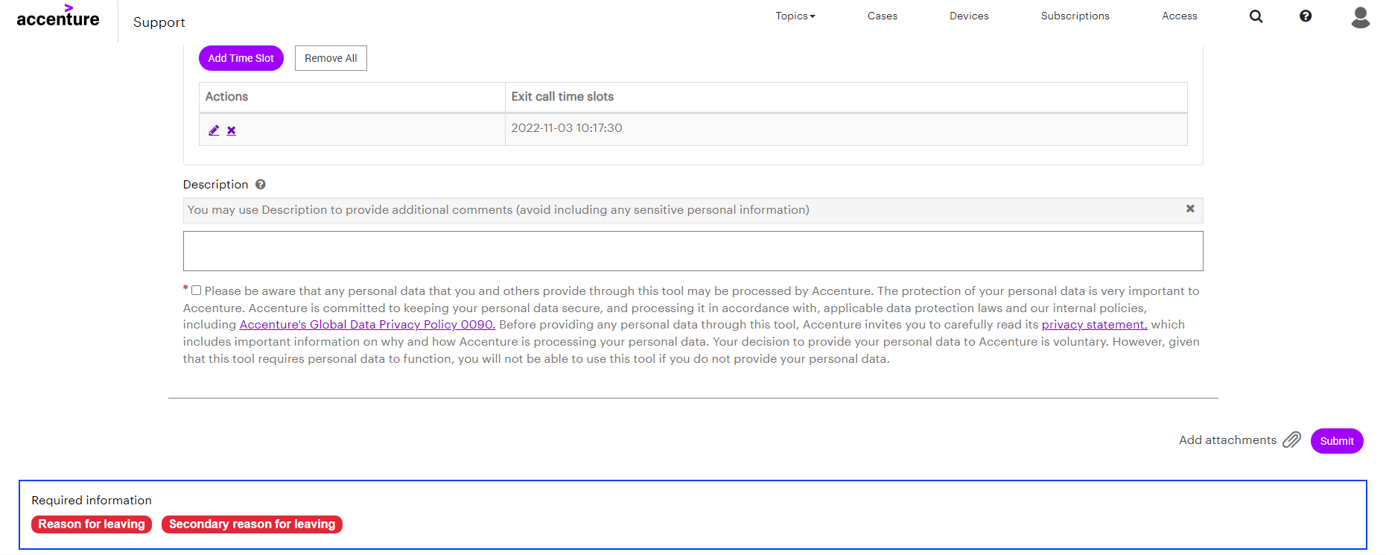
Employee Exit Job Aid
18
Check the box after reading the statement
19
Add any attachments (if needed) and click Submit
9

Slide 11
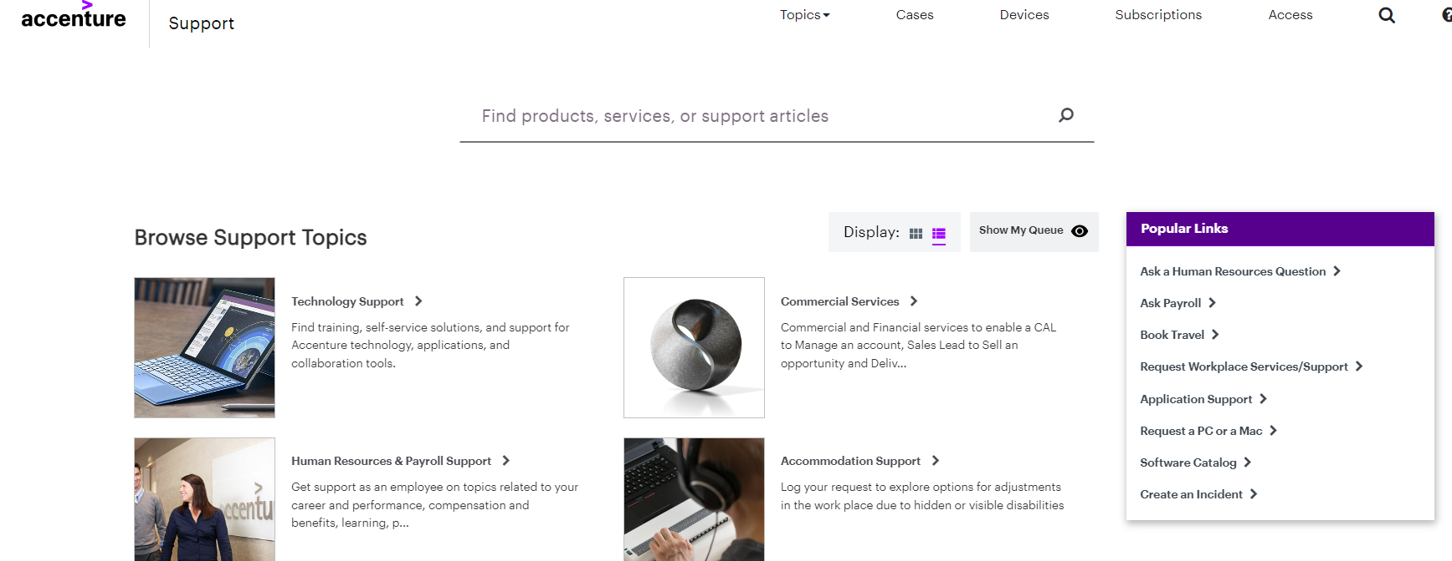
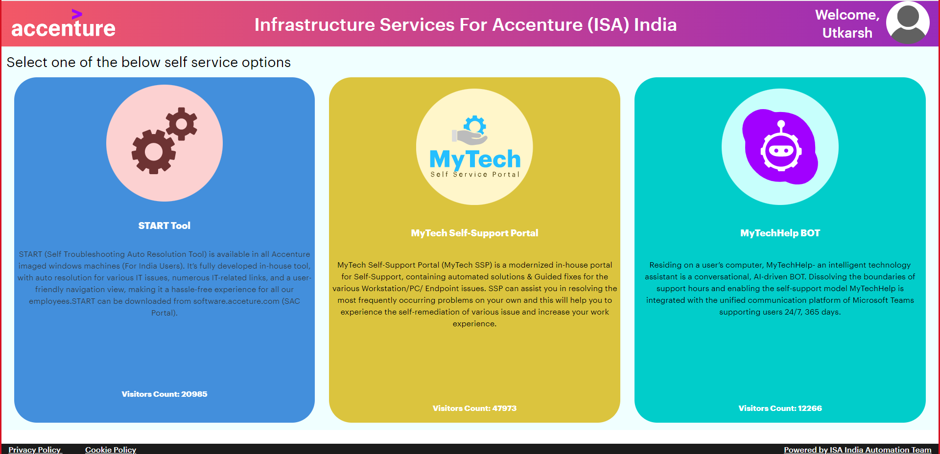
Technical Issue Resolution
1
To report a technical issue, click the Create an Incident link
2
Click START Tool
9

Slide 12
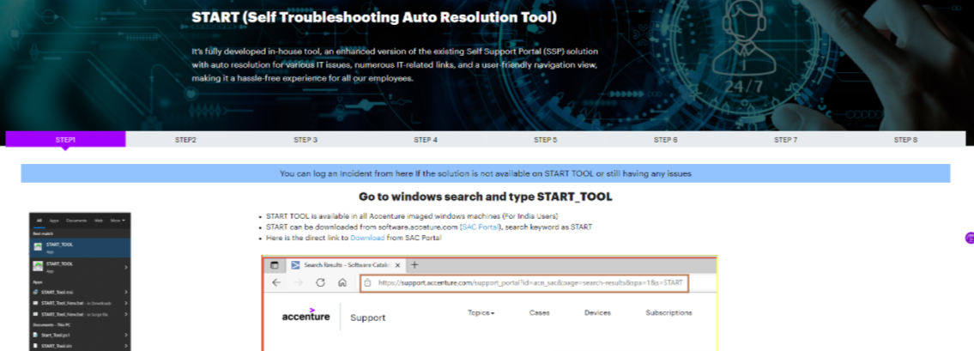
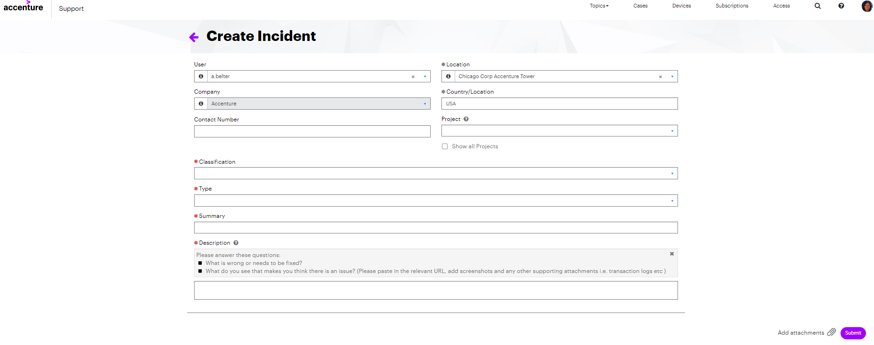
Technical Issue Resolution
3
Click the blue bar to Access the Create Incident form
Fill out the required Fields and attach any necessary documentation. Click Submit
4
9

Slide 13
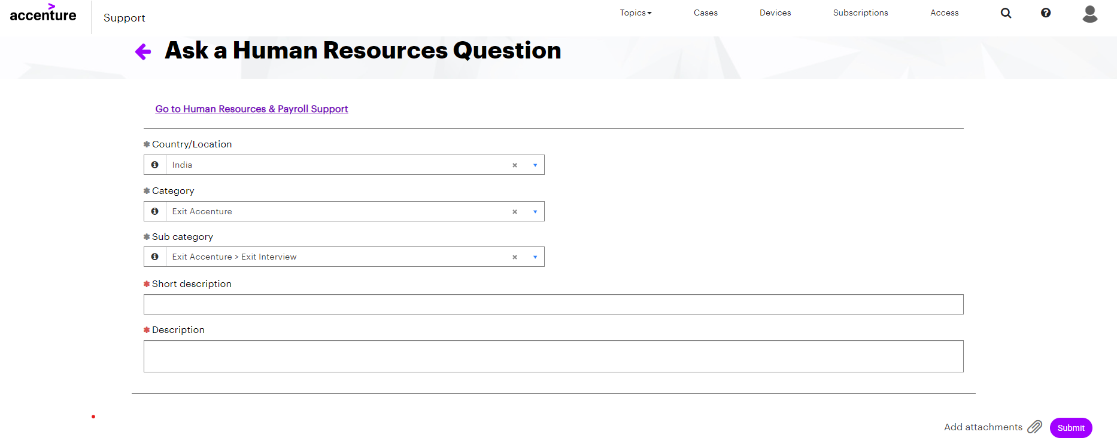
Process Issue Resolution
1
To report an exit process issue, click the Ask a Human Resources Question link
Fill out the required Fields and attach any necessary documentation. Click Submit
2
9

